Slide 1
USING MACHINE LEARNING METHODS TO TEST THE EFFICIENT MARKET HYPOTHESIS
MACT6100 Final Project
Lwazi Majenge

Slide 2

Motivation
Why predict market direction?
Daily S&P 500 direction is notoriously difficult to forecast.
Finance theory (EMH) argues that prices follow a random walk, making short-term prediction almost impossible.
Yet quantitative trading research suggests that weak, short-lived patterns might exist in technical indicators.
Even a 1–2% improvement above chance could matter when scaled to large volumes.
This creates a natural tension: market efficiency vs. statistical predictability.

Slide 3

Research Questions
What this project investigates:
Predictive signal:
Can historical OHLCV data and technical indicators produce accuracy meaningfully above 50%?
Model comparison:
Do flexible, non-linear models (Random Forest, GBM, DNN) outperform logistic regression?
Feature relevance:
Which technical indicators (momentum, trend, volatility, oscillators) matter most?
Overall goal:
Test whether any exploitable structure exists in next-day S&P 500 movement.

Slide 4

Data & Methodology
Data:
Daily S&P 500 price data (after removing pre-1950 rows with missing volume).
Final dataset: 17,808 trading days.
Technical indicators generated: RSI, SMA10/50/200, MACD, Bollinger %B, volatility, momentum, stochastics, etc.
Target variable: Up vs Down, based on tomorrow’s close.
Methodology:
Chronological train/test split (70% train, 30% test).
Standardisation via recipes.
Models: GLM, Random Forest, GBM, Neural Network.
Primary metric: ROC-AUC (robust to class imbalance).
Secondary metrics: accuracy & balanced accuracy.

Slide 5
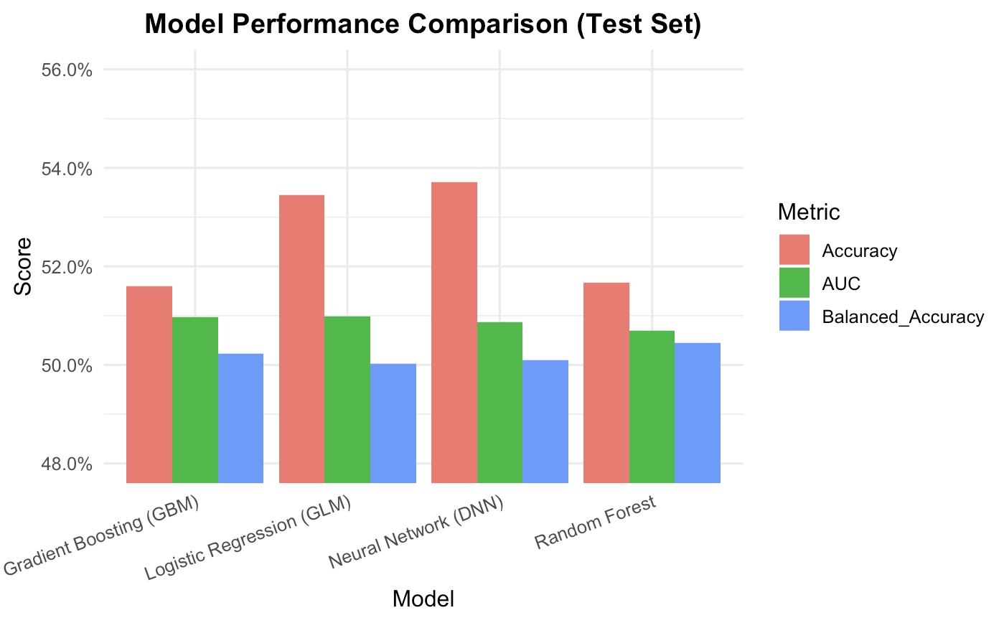
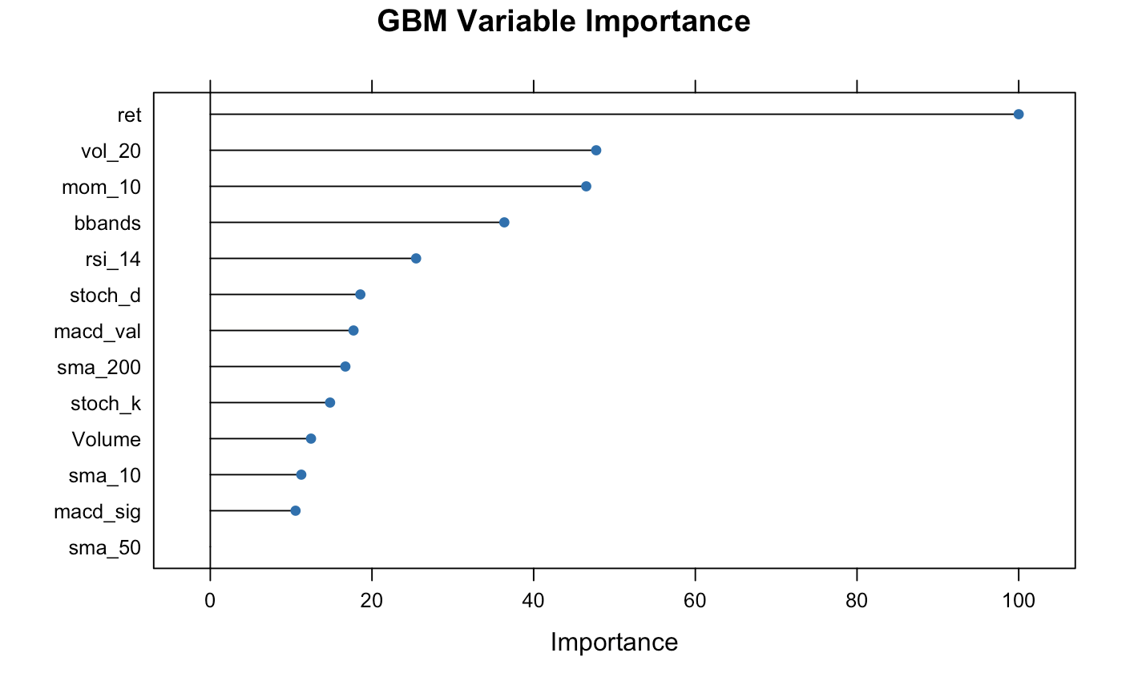
Key Findings:
All models perform only marginally above chance.
Balanced accuracy ≈ 0.50 → equivalent to random guessing.
Neural network collapses to predicting “Up” most of the time, mirroring market bias.
No model outperforms the baseline (always predicting Up).
Variable importance (RF/GBM):
Momentum (ret, mom_10), Bollinger %B, volatility, and stochastics rank highest.
Long-term trend indicators (SMA50/200) show little predictive power.

Slide 6

What do the results tell us?
Daily S&P 500 direction is extremely hard to predict.
Even sophisticated models do not uncover a stable signal.
This strongly supports the Efficient Market Hypothesis:
historical prices and technical indicators hold very limited short-term predictive information.
Conclusion:
None of the models achieved meaningful predictive accuracy or AUC.
Complex methods (RF, GBM, DNN) offered no improvement over logistic regression.
Markets remain very close to random at a 1-day forecast horizon.
Future Work:
Use intraday data, macroeconomic variables, or volatility forecasting.
Try alternative targets (e.g., return magnitude instead of direction).

